Slide 1
Hierarchical Graph Neural Networks
A seminar presentation for HO-GNN WS2024/25
Mohammad Shaique Solanki – 7062950

Slide 2
Content
Introduction
Background
Observing Hierarchy in Graph Datasets
Fundamentals of Hierarchical GNNs
Diffpool Mechanism
Challenges and Limitations

Slide 3
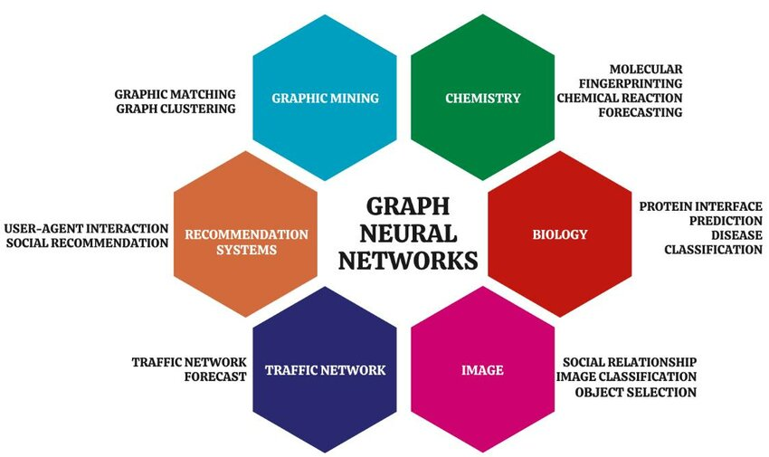
1. Introduction
Motivation == Graphs are everywhere

Slide 4
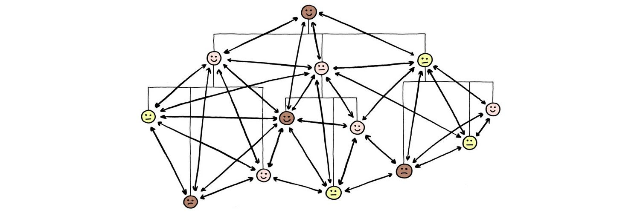
1. Introduction
Objective == Learning the hierarchy in the graphs
Scientists at Indian Institute of Science, Bangalore used Hierarchical GNNs for Speaker diarization problem.

Slide 5
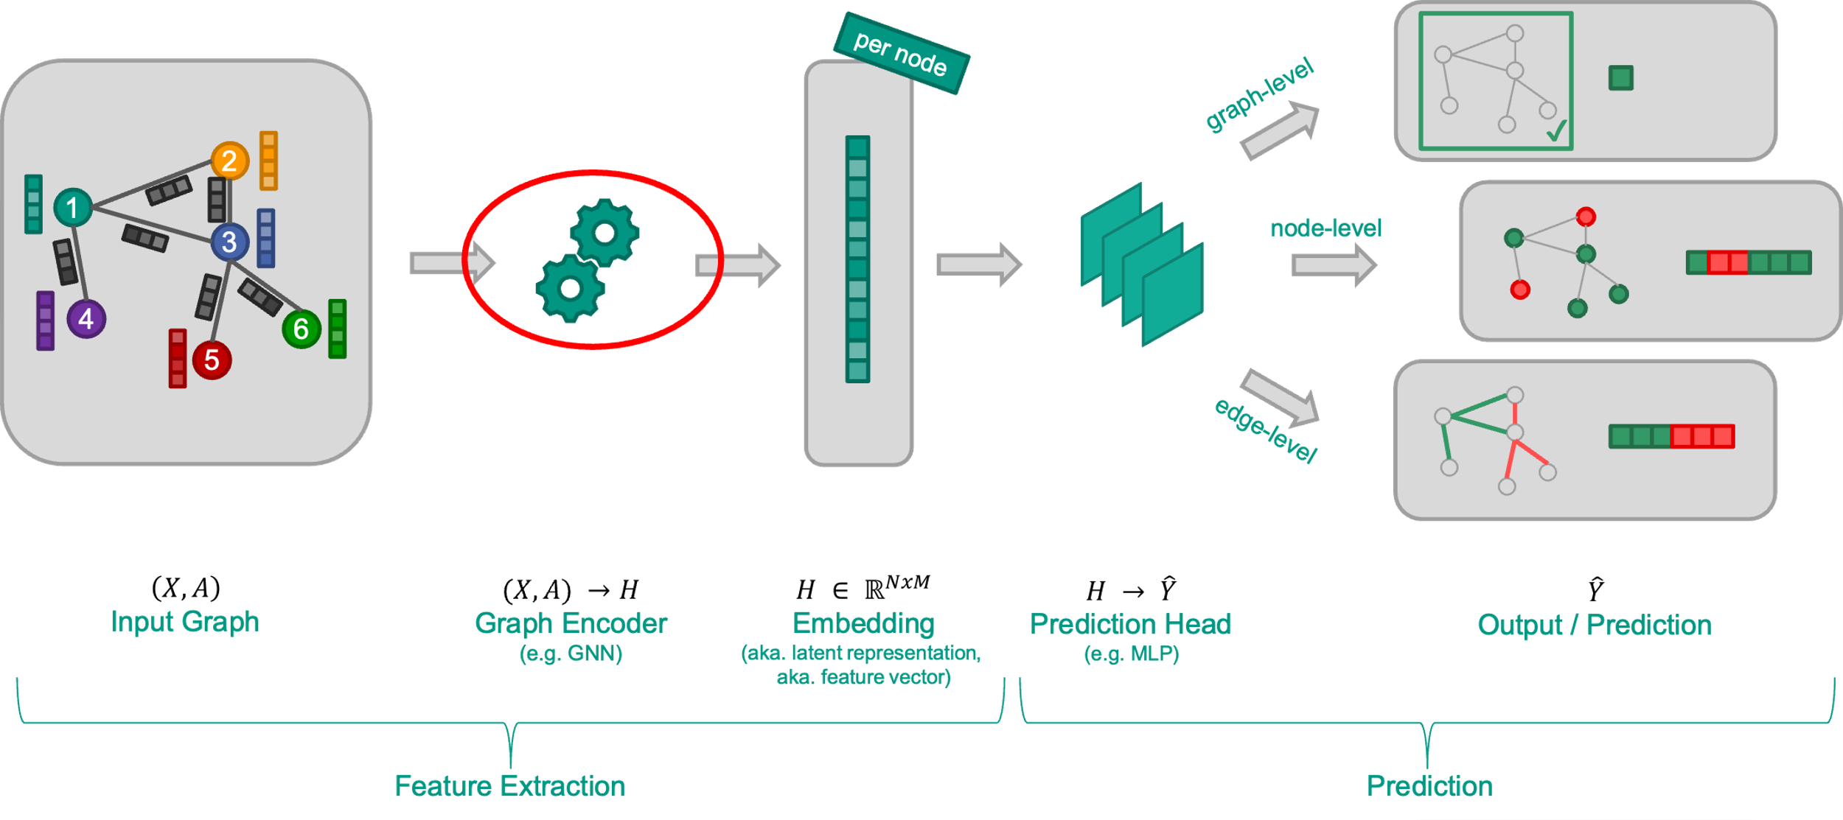
2. Background
What are GNNs? How do they work?

Slide 6
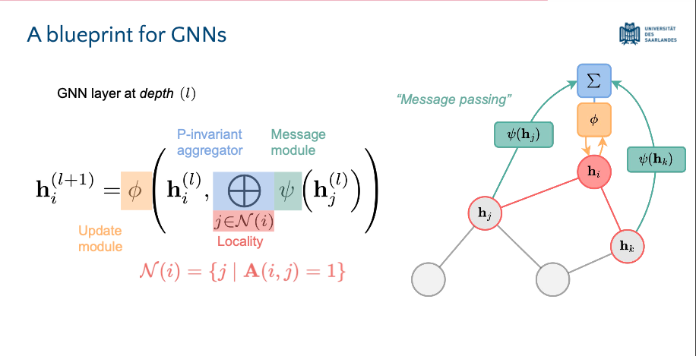
2. Background
Uniform Processing Across Layers
Each layer uniformly transforms neighbour node features using ψ (e.g., via a weight matrix) before aggregation, applying the same operations irrespective of the layer depth.
Simple Aggregation Method
Uses a straightforward aggregation function ⨁, typically a mean or weighted sum, without adapting to node features or graph complexity, reinforcing the flat architecture design.

Slide 7
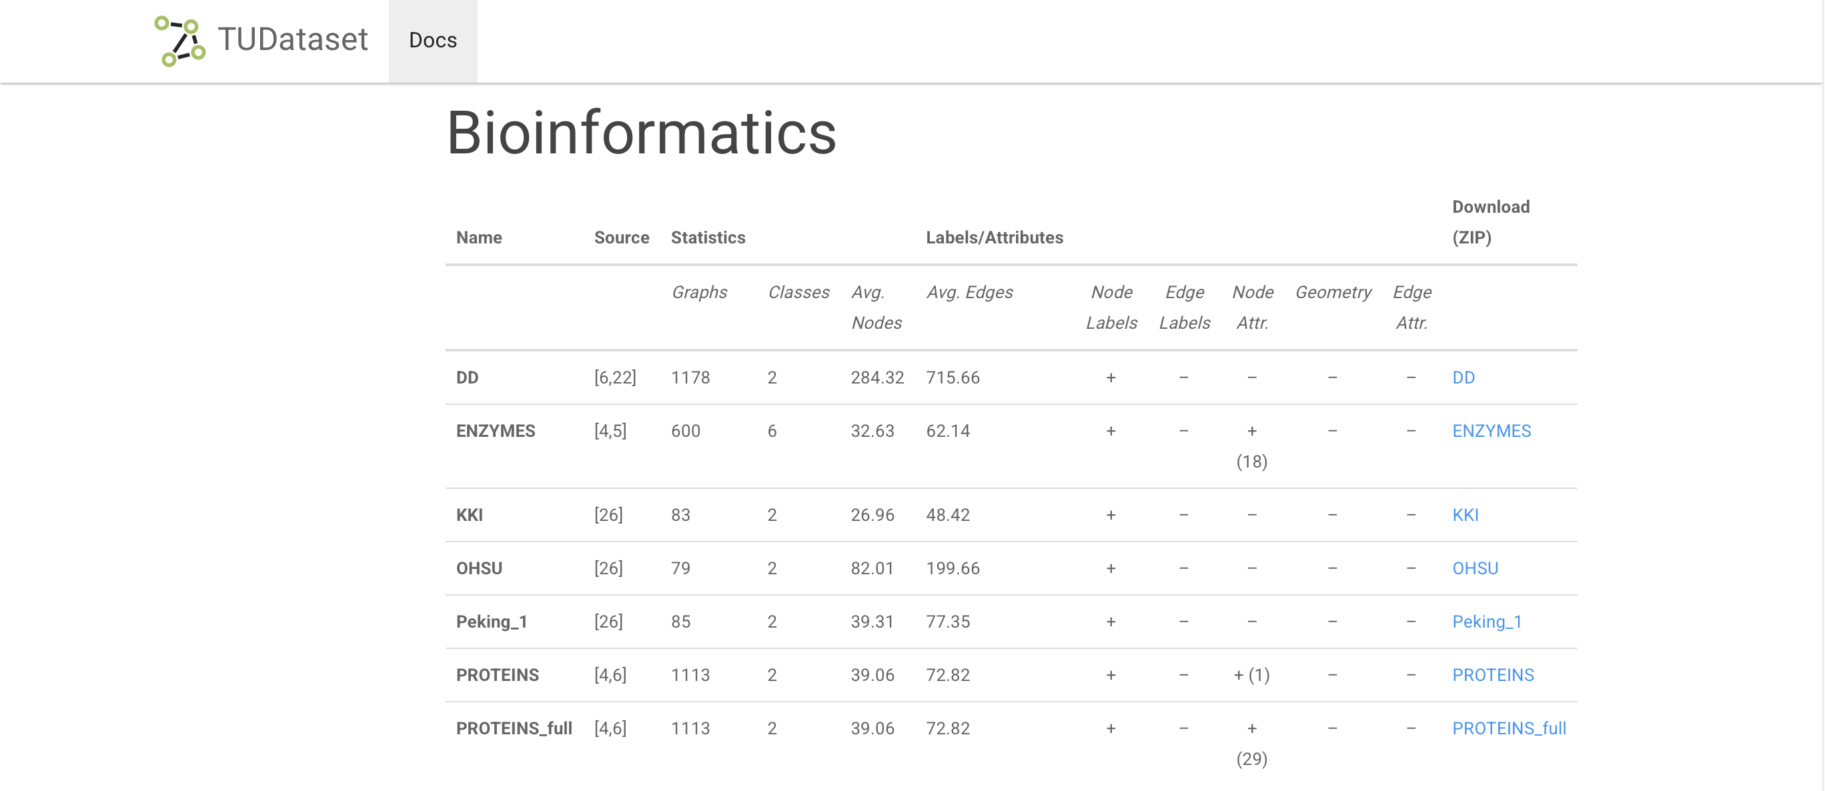
3. Observing Hierarchy in Graph Datasets

Slide 8
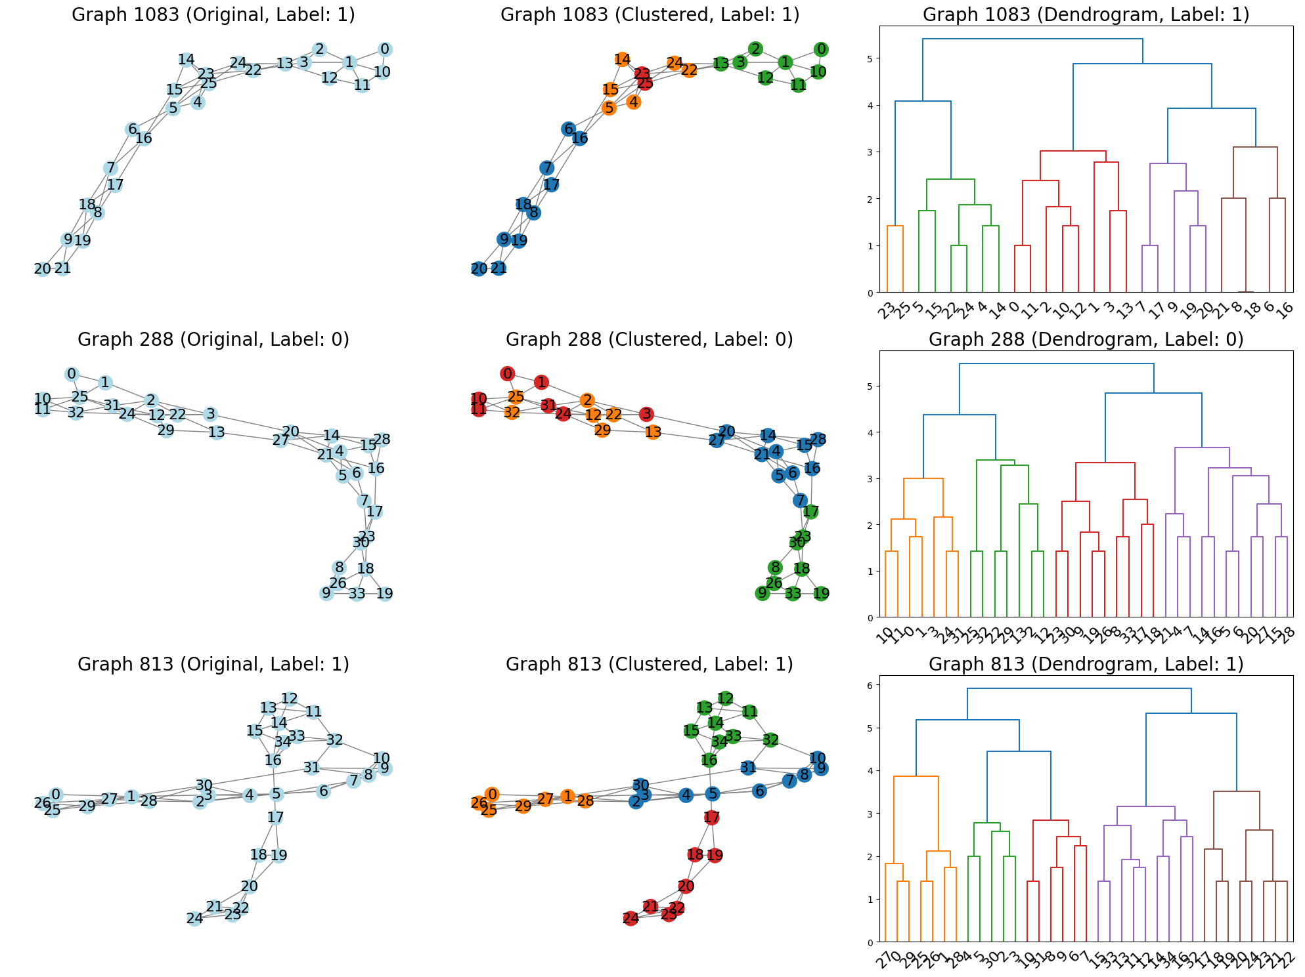
3. Observing Hierarchy in Graph Datasets

Slide 9
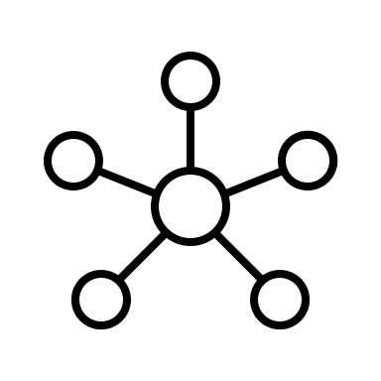
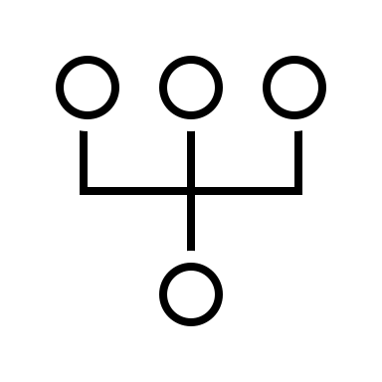
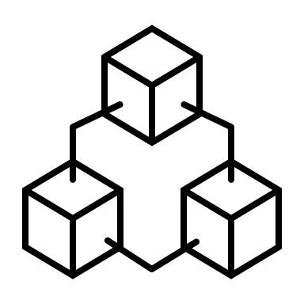
3. Observing Hierarchy in Graph Datasets
Model Architecture
GCNConv1
Input_graph
GCNConv2
global_mean_pool
DropOut = 0.5
Output(Class :0/1)
GCNConv3

Slide 10
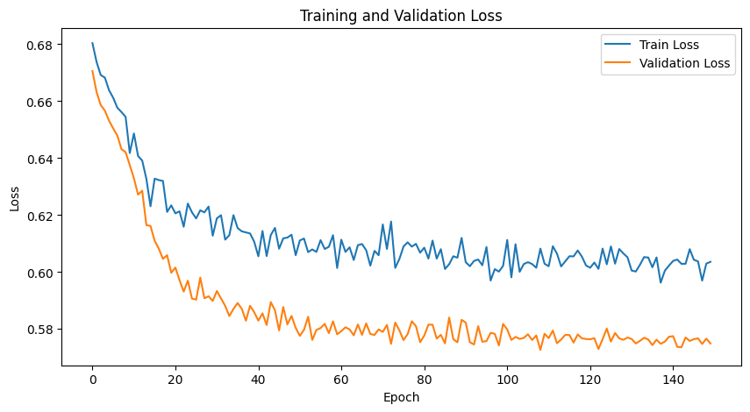
3. Observing Hierarchy in Graph Datasets
Overview of results
Final Test Accuracy: 0.7232, Test Loss: 0.5846

Slide 11
3. Observing Hierarchy in Graph Datasets
Over-smoothing
Analysis
Difficulty in learning long-range dependency
So what’s happening?
Scalability Issues
Inability to capture multi-level structure

Slide 12
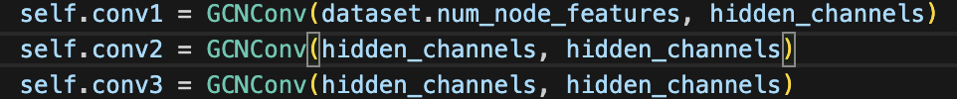
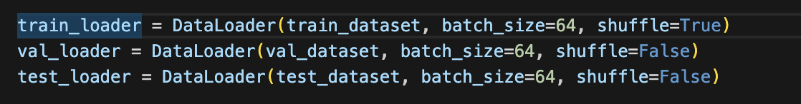
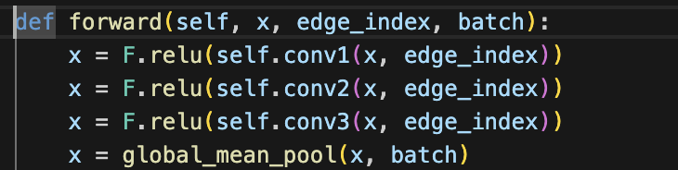
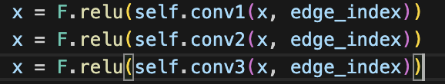
3. Observing Hierarchy in Graph Datasets
Analysis – Diving Deep
Problem | Culprit
Over-Smoothing
Scalability Issues
Inability to Capture Multi-Scale Structures
Difficulty in Learning long-range dependencies
Stacking multiple GCN layers without preserving distinct node features of incorporate different layers of abstraction

Slide 13
3. Observing Hierarchy in Graph Datasets
Analysis – Diving Deep
Problem | Culprit
Over-Smoothing
Scalability Issues
Inability to Capture Multi-Scale Structures
Difficulty in Learning long-range dependencies
Stacking multiple GCN layers without preserving distinct node features of incorporate different layers of abstraction

Slide 14
3. Observing Hierarchy in Graph Datasets
Analysis – Diving Deep
Problem | Culprit
Over-Smoothing
Scalability Issues
Inability to Capture Multi-Scale Structures
Difficulty in Learning long-range dependencies
Using a static batch size for processing large, complex graphs like proteins, where node and edge counts vary, can cause scalability issues and inefficiencies in memory and computational resources.

Slide 15
3. Observing Hierarchy in Graph Datasets
Analysis – Diving Deep
Problem | Culprit
Over-Smoothing
Scalability Issues
Inability to Capture Multi-Scale Structures
Difficulty in Learning long-range dependencies
The model's uniform convolutional layers and global mean pooling lack the ability to capture multi-scale features essential for hierarchical structures like proteins.

Slide 16
3. Observing Hierarchy in Graph Datasets
Analysis – Diving Deep
Problem | Culprit
Over-Smoothing
Scalability Issues
Inability to Capture Multi-Scale Structures
Difficulty in Learning long-range dependencies
While graph convolutions theoretically capture long-range dependencies through layer stacking, in practice, the repetitive application of uniform convolutions across entire graphs fails to effectively address long-range interactions in large, complex structures.

Slide 17
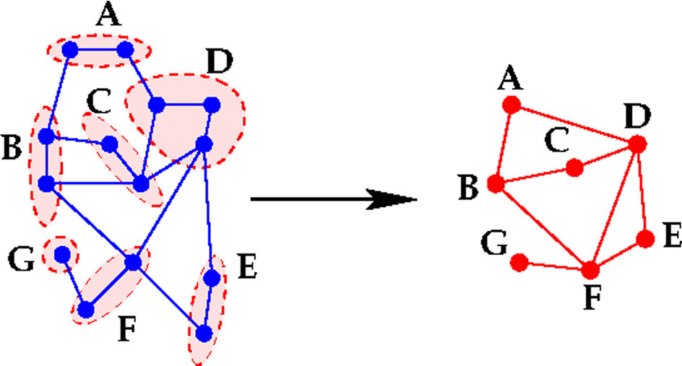
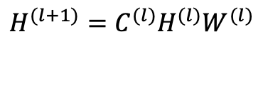
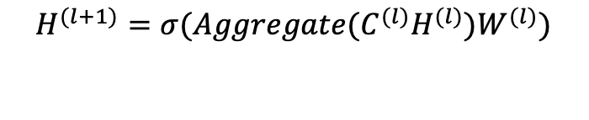
4. Fundamentals of Hierarchical GNN
Graph Coarsening
Capturing the Hierarchy
G
G’
$$H^{(l+1)}={σ(Aggregate(C}^{(l)}H^{(l)})W^{(l)})$$
σ is a nonlinear activation function that introduces nonlinearity
AGGREGATE could be a function like sum, mean, or more complex
learned function, which combines features of the nodes which
have been merged together.
$$H^{(l+1)}=C^{(l)}H^{(l)}W^{(l)}$$
H^{(l)} is the matrix of node features at layer (l)
W^{(l)} is the weight matrix at layer (l), which transforms the node features.
C^{(l)} is the coarsening matrix which reduces the number of nodes by merging them

Slide 18
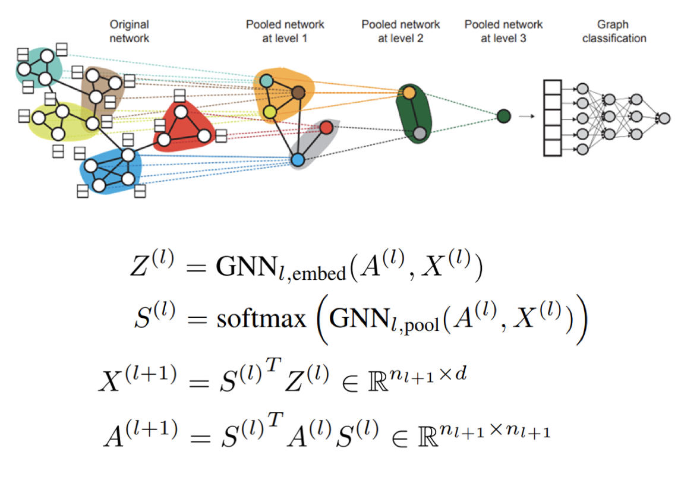
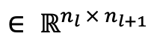
5. Diffpool Mechanism
i/p Adj Mat
i/p Feat Mat
Node embeddings at layer l
Learned cluster assignment matrix at layer l
$$∈ ℝ^{n_{l} × n_{l+1}}$$
o/p Feat Mat
o/p Adj Mat

Slide 19
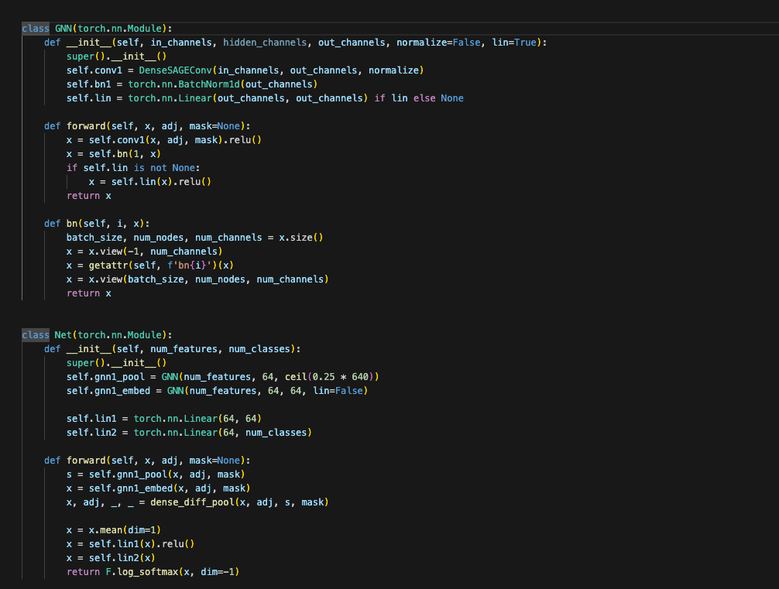
5. Diffpool Mechanism - Implementation

Slide 20
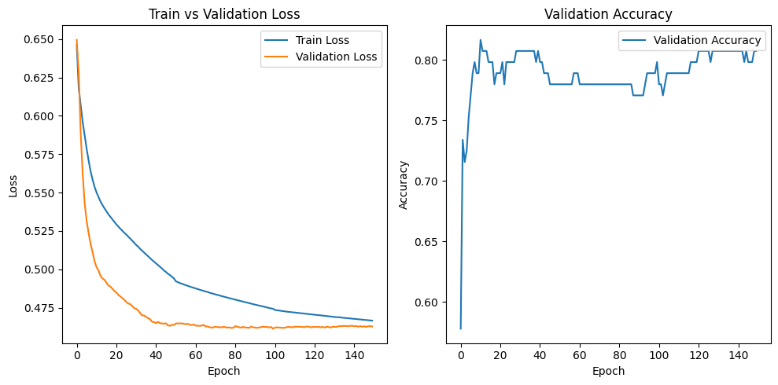
5. Diffpool Mechanism - Implementation
Final Test Accuracy with diffpool : 0.78, Test Loss: 0.48
Final Test Accuracy w/o : 0.7232, Test Loss: 0.5846

Slide 21



5. Diffpool Mechanism
Over-smoothing
Analysis
Difficulty in learning long-range dependency
So what’s happening?
Scalability Issues
Inability to capture multi-level structure

Slide 22
6. Tying it all up
Flat GNN methods
Struggles with large data due to computation limitations
Operates at a single level of graph representation, which may limit the complexity of patterns captured.
Hierarchical Learning w Diffpool
Better handles larger graphs through hierarchical reductions
Learns multi-level hierarchical representations, potentially capturing deep patterns
Risk of over-smoothing can still exist, but controlled through hierarchical processing.

Slide 23

Questions

Slide 24

Thank you!!!

